Slide 1


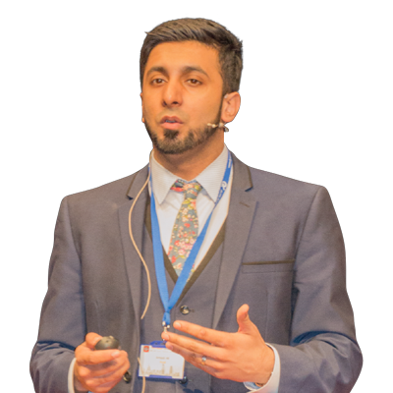

BASL – Removing Barriers: Practical Strategies for Learning and Behaviour
Amjad Ali
Date | Time | Location
06.10.25 | 9.30 -12pm | The Holiday Inn, Aylesbury HP22 5QT
Description
A practical, hands-on seminar that helps you overcome barriers to learning. Based on the idea that strategies for some benefit all, it focuses on adapting classroom practice to support every pupil. Leaders will learn ways to boost engagement, reduce disruption, and build routines that foster resilience and self-regulation
Outcomes
Inclusive Classrooms: Leaders create supportive routines and environments for all learners.
Improved Learning & Behaviour: Pupils show greater engagement and resilience, leading to fewer disruptions and better achievement.
Cost: £10 for BASL members, £60 for non-members
To book a place, please click HERE
In partnership with
Email: BASL@buckinghamshire.gov.uk

