Slide 1


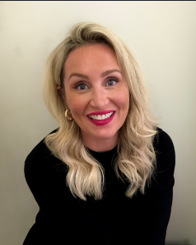

BASL – Inclusion & Diversity
Hannah Hall from The Excellence Hub – 30th January 2026
Date | Time | Location
30.01.26 | 9.30 -12pm | Online TEAMS
Description
Join us for an inspiring seminar on Inclusion and Diversity, led by Hannah. This session will focus on:
Learning Behaviours, closing the attainment gap for disadvantaged learners
Her impactful work includes:
Stoke Learning Behaviours Programme, Key Stage 3 SEND Pilot in partnership with the Maths Hub
Hannah is an expert in behaviour management and inclusive pedagogy, known for turning research into practical strategies that drive change. She delivers impactful keynotes and training worldwide, inspiring leaders to embrace equity and excellence for all learners.
Outcomes
New Strategies based on recent new research
Ideas on engaging parents
Cost: £10 for BASL members, £60 for non-members
To book a place, please click HERE
In partnership with
Email: BASL@buckinghamshire.gov.uk

